Slide 1

Notes to Instructor
Material Needed
Hard copies of the following:
ADaM Model Document v2.1
ADaM IG v1.1
ADaM Basic Data Structure for Time to Event v1.0
with labelled Post-It notes attached to the first page of each document
Each participant will need to bring their laptop to access workshop templates needed to complete workshop exercises
Excel file Exercise Templates and additional electronic resources on the External SharePoint site

Slide 2
Electronic Documents Required
ADaM Workshop Module 5.pptx (this power point)
Participants will need the following for exercises:
Lilly ADaM Mod 5 Exercise.xlsx
adam_ct_vl.xlsx
onc_tfl_tte_summ_OS.xlsx
onc_ADaM_ADTTE.xlsx
For Reference:
ADaM Model Document v2.1
ADaM IG v1.1
ADaM Basic Data Structure for Time to Event v1.0

Slide 3
Lilly Workshop Module 5 Basic Data Structure Advanced Topics

Slide 4
Objectives
Encourage participation to enhance learning in this hands-on workshop
Describe the importance of DTYPE and recognize when it should be used
Understand the rules of BDS regarding adding columns versus rows
Know how to use BDS to develop a dataset for time to event (TTE) analysis

Slide 5
Analysis Descriptor Variable: DTYPE – Derivation Type

Slide 6
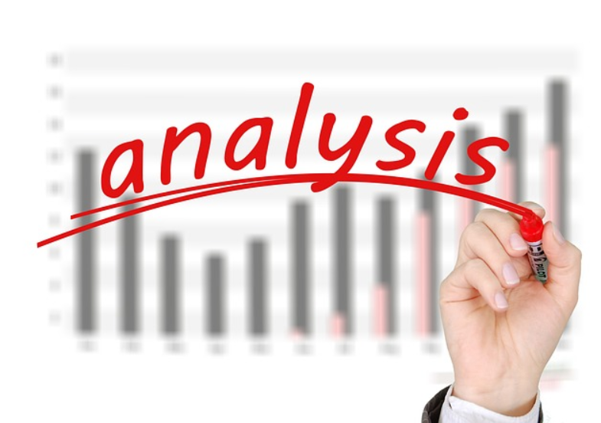
Analysis Descriptor Variables
Analysis Descriptor Variables are special purpose variables (e.g., DTYPE) and are used to describe something important about a given row, generally in regard to AVAL / AVALC
For example:
On a given row, is the value of AVAL derived or imputed differently than other rows?
Which row(s) is used for analysis?
Is there something special about the row that is important to highlight?

Slide 7
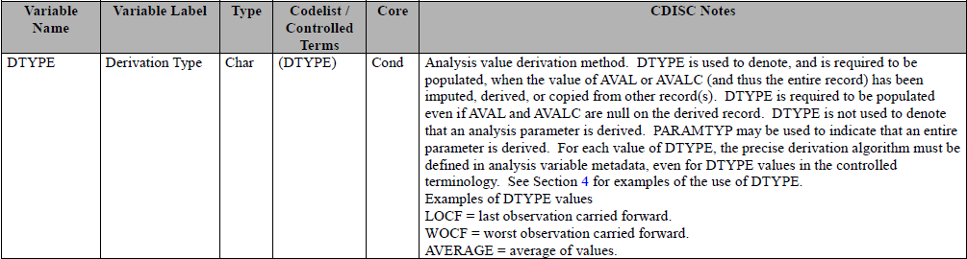
DTYPE – Derivation Type
When AVAL / AVALC is derived or imputed differently than other records within the parameter, then the variable DTYPE is used to indicate the method of derivation
The value of DTYPE indicates that AVAL / AVALC was derived AND gives an indication of the method
Notes:
Screen shot is from ADaMIG v1.0 – CDISC notes are very small and are not intended to be read as part of training workshop

Slide 8
Example 1: SDTM.LB
SDTM LB Data:
SAP language:
The baseline value of hemoglobin is defined as the average of all screening and pre-treatment values
USUBJID | VISIT | LBTESTCD | LBSTRESN | LBSTRESU
L445-1001-00003 | Day -3 | HGB | 10.6 | gm/dL
L445-1001-00003 | Day -2 | HGB | 14.6 | gm/dL
L445-1001-00003 | Day -1 | HGB | 13.2 | gm/dL
L445-1001-00003 | Pre-Trt | HGB | 13.0 | gm/dL
L445-1001-00003 | Day 1 | HGB | 14.2 | gm/dL

Slide 9
Example 1: DTYPE ADaM.ADLB
USUBJID | AVISIT | PARAMCD | AVAL | DTYPE | ABLFL
L445-1001-00003 | Baseline | HGB1 | 10.6
L445-1001-00003 | Baseline | HGB1 | 14.6
L445-1001-00003 | Baseline | HGB1 | 13.2
L445-1001-00003 | Baseline | HGB1 | 13.0
L445-1001-00003 | Baseline | HGB1 | 12.85 | AVERAGE | Y
L445-1001-00003 | Day 1 | HGB1 | 14.2
A new row was added for the derived baseline value
Population of DTYPE indicates it was derived and derived by creating an average
Which records used for average would be described in metadata and/or reflected in value of AVISIT

Slide 10
Example 2: SDTM.LB
SDTM LB Data:
SAP language:
If hemoglobin is not collected at a visit, use method of last observation carried forward to impute missing value
USUBJID | VISIT | LBTESTCD | LBSTRESC | LBSTRESN | LBSTAT
L445-1001-00003 | Week 2 | HGB | 10.6 | 10.6
L445-1001-00003 | Week 4 | HGB | 14.6 | 14.6
L445-1001-00003 | Week 6 | HGB |  |  | Not Done
L445-1001-00003 | Week 8 | HGB | 13.0 | 13.0
L445-1001-00003 | Week 10 | HGB | 14.2 | 14.2

Slide 11
Example 2: DTYPE ADaM.ADLB
USUBJID | AVISIT | PARAMCD | AVAL | DTYPE
L445-1001-00003 | Week 2 | HGB1 | 10.6
L445-1001-00003 | Week 4 | HGB1 | 14.6
L445-1001-00003 | Week 6 | HGB1 | 14.6 | LOCF
L445-1001-00003 | Week 8 | HGB1 | 13.0
L445-1001-00003 | Week 10 | HGB1 | 14.2
AVAL is imputed for Week 6
Population of DTYPE indicates it was derived and derived by carrying forward last available value for the subject

Slide 12

DTYPE – Other Examples
Creation of Derived Visits such as
AVISIT = “Month 3 Endpoint”
AVISIT = “Post Baseline Maximum”
Imputation of AVAL due to collected assessment value being below quantifiable limits or in a range,
LBORRES | AVAL | DTYPE
<10 | 10 | BQL
2-6 | 4 | INTERP

Slide 13
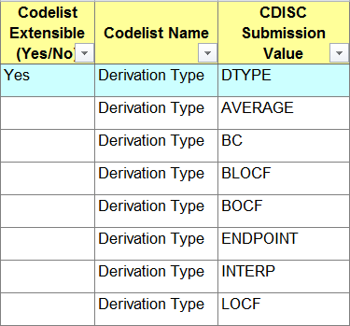
DTYPE Controlled Terminology
DTYPE is one of the few ADaM variables that has published CT
The code list for DTYPE is Extensible

Slide 14
Group Exercise / Discussion

Slide 15

Group Exercise – DTYPE Review
Open the Excel document entitled “adam_ct_vl.xlsx” and open the CT tab
Filter Column B “CTLIST” for the value “CTA.DTYPE”
Read the DECODE of each DTYPE value
Which entries describe imputations that you seen before in your project work?
Are there imputation methods that are not on this list?

Slide 16
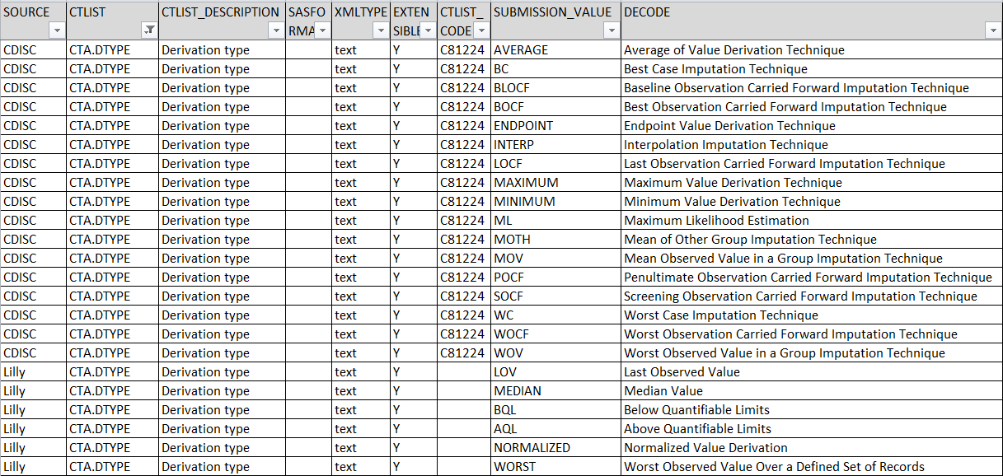
CTA.DTYPE

Slide 17
Group Discussion – DTYPE Review
Open Discussion…
What is the process for deciding which value of DTYPE is appropriate?
What is the difference between WC, WOCF, WOV, WORST?
What is the process for deciding a new value of DTYPE is needed?

Slide 18
Analysis Descriptor Variables: Visit Windows and Analysis Record Flags

Slide 19
Visit “Windowing” for Analysis
Analysis Visit Windows
Defined in the SAP
Describe the allowable span of time that given assessment can be made and considered analyzable as a value for a given defined visit
Visit Window 1 Visit Window 2 Visit Window 3
Visit 1 Visit 2 Visit 3
Target 1 Target 2 Target 3
Every visit window has a target time for the assessment and an allowable amount of time on either side of this target

Slide 20
Allowable Windowing Variables
PARAMCD | AVISIT | ADY | AWTARGET | AWTDIFF | AWLO | AWHI | AWU
DIABP | Week 2 | 12 | 14 | -2 | 1 | 20 | DAYS
DIABP | Week 4 | 23 | 28 | -5 | 21 | 34 | DAYS
DIABP | Week 4 | 29 | 28 | 1 | 21 | 34 | DAYS
DIABP | Week 6 | 43 | 42 | 1 | 35 | 49 | DAYS
DIABP | Week 8 | 58 | 56 | 2 | 50 | 62 | DAYS
Values of green variables come from SAP
These are useful for programming to slot visits into the defined visit windows
All variables are permissible

Slide 21
ANLzzFL – Analysis Record Flag
ANLzzFL is an indicator variable that is highly flexible and useful
When ANLzzFL = “Y” it indicates that the record satisfies the “zz” analysis algorithm
This algorithm is described in metadata for ANLzzFL
PARAMCD | AVISIT | ADY | AWTARGET | AWTDIFF | ANL01FL
DIABP | Week 2 | 12 | 14 | -2
DIABP | Week 4 | 23 | 28 | -5
DIABP | Week 4 | 29 | 28 | 1 | Y
Notes:
A common use case is to identify the record used for analysis when more than one assessment was done within a visit window

Slide 22
ANLzzFL Example
PARAMCD | AVISIT | ADY | AWTARGET | AWTDIFF | AWLO | AWHI | ANL20FL
DIABP | Week 2 | 12 | 14 | -2 | 1 | 20 | Y
DIABP | Week 4 | 23 | 28 | -5 | 21 | 34
DIABP | Week 4 | 29 | 28 | 1 | 21 | 34 | Y
DIABP | Week 6 | 43 | 42 | 1 | 35 | 49 | Y
DIABP | Week 8 | 58 | 56 | 2 | 50 | 62 | Y
In this example, the record closest to the target day is selected for analysis for Week 4
The non-selected record remains in the data for traceability and support of alternate analyses

Slide 23
Rules for BDS

Slide 24

BDS Rule #1 - #6
Open ADaMIG v1.1(pages 58 – 70) and follow along!
BDS has a definable structure but also has flexibility
Too much flexibility can lead to lack of standardization and loss of efficiency
Primarily the rules address when it is allowable to add derived columns versus add rows to BDS

Slide 25
Rule #1: AVAL Parameter Invariant
We can add derived columns that are functions of AVAL and optionally BASE if that column is derived the same way for all parameters in that data set
This is the concept of “Parameter-Invariant”
No transformations of AVAL or BASE are allowed
PARAM | PARAMCD | AVAL | BASE | CHG
Pulse Rate (bpm) | PULSE | 70 | 62 | 8
Sitting Diastolic Blood Pressure (mmHg) | DIABPSI | 80 | 71 | 9

Slide 26
Rule #2: AVAL Does Not Satisfy Rule #1
A transformation of AVAL that is not parameter invariant should be added as a new set of rows with a new PARAM
PARAM | PARAMCD | AVAL | BASE
LDL Cholesterol (mg/dL) | LDL | 107.4 | 213.4
LDL Cholesterol (mg/dL) | LDL | 90.2 | 213.4
LDL Cholesterol (mmol/L) | LDLT | 2.7773 | 5.5185
LDL Cholesterol (mmol/L) | LDLT | 2.3326 | 5.5185
Notes:
Recall that the text of PARAM must contain units!

Slide 27
Rule #3: Creating Analysis Time Point
When creating a analysis time point that is a function of one or more rows of the same parameter, new row(s) should be added for this parameter
PARAM | AVISIT | VISITNUM | AVAL | BASE | DTYPE
Weight (kg) | Screening | 1 | 99 | 99
Weight (kg) | Week 1 | 2 | 101 | 99
Weight (kg) | Endpoint | 999 | 100 | 99 | AVERAGE

Slide 28
Rule #4: Multiple Rows Within a PARAM
Functions of multiple rows within a parameter should be added as a new parameter
PARAM | PARAMCD | AVISIT | AVAL
Number of Episodes | NUMEPI | Week 1 | 3
Number of Episodes | NUMEPI | Week 2 | 5
Number of Episodes | NUMEPI | Week 3 | 0
Number of Episodes | NUMEPI | Week 4 | 2
Cumulative Number of Episodes | CUMUEPI | Week 1 | 3
Cumulative Number of Episodes | CUMUEPI | Week 2 | 8
Cumulative Number of Episodes | CUMUEPI | Week 3 | 8
Cumulative Number of Episodes | CUMUEPI | Week 4 | 10

Slide 29
Rule #5: Function of > 1 PARAM
Functions of more than one parameter should be added as a new parameter with a new set of rows
PARAM | PARAMCD | AVISIT | AVISITN | AVAL
Total Cholesterol (mg/dL) | CHOL | Week 0 | 0 | 266
High-Density Lipoprotein Chol (mg/dL) | HDL | Week 0 | 0 | 42
Total Cholesterol: HDL-C ratio | CHOLH | Week 0 | 0 | 6.33

Slide 30
Rule #6: More Than 1 Baseline
When there is more than 1 definition of baseline, each definition of baseline requires the duplication of rows that are analyzed using the definition
PARAM | AVISIT | AVAL | BASE | CHG | BASETYPE
QTCBAZ | Scrn 1 | 420
QTCBAZ | Scrn 2 | 390
QTCBAZ | Baseline | 390 | 390 |  | Last Obs
QTCBAZ | Baseline | 420 | 420 |  | Maximum
QTCBAZ | Month 1 | 394 | 390 | 4 | Last Obs
QTCBAZ | Month 1 | 394 | 420 | 26 | Maximum
Notes:
Each row is duplicated so that we can calculate CHG (and add any other variable such as CRITy)
In order to clearly distinguish between these 2 definitions, we use BASETYPE that contains a text description of the BASE definition. This is a requirement
Summary: You have probably noticed that most of the time we add sets of rows, not additional columns
We can only add columns that are functions of AVAL (and BASE) when the same function applies to ALL parameters in a dataset
This does not apply to columns that are supportive or used for categorization or flagging or criteria

Slide 31
Lilly Module 5 Exercise #1

Slide 32
Lilly Mod 5 Exercise #1
Open Lilly ADaM Mod 5 Exercise.xlsx
Based on BDS Rule #1, determine which of the scenarios are:
Allowed? Why?
Not Allowed? Why Not?
REMINDER Rule #1: We can add derived columns that are functions of AVAL and optionally BASE if that column is derived the same way for all parameters in that data set

Slide 33
Let’s Try The First One Together
“Adding a column DTYPE using different values for different values of PARAM”
Allowable or Not Allowable by Rule #1?
Allowable
Why or Why Not?
Rule #1: DTYPE is not a derived column that is a function of AVAL or BASE. It is an analysis descriptor column that helps identify the derivation of an imputed value of AVAL

Slide 34
Exercise #1 Answer
Q1 | Adding a column DTYPE using different values for different values of PARAM
Answer: Allowable | DTYPE is not a derived column that is a function of AVAL or BASE. It is an analysis descriptor column that helps identify the derivation of an imputed value of AVAL
Q2 | Adding columns for traceability purposes that might be populated for some values of PARAM but blank for others
Answer: Allowable | Variables for traceability are not functions of AVAL or BASE
Q3 | Adding a column that involve the use of AVAL or BASE that appear on a different row, such as cumulative value of AVAL over time
Answer: Not Allowable | This involves functions of AVAL or BASE AND involve values from other records. Also, the meaning of PARAM would no longer be appropriate

Slide 35
Exercise #1 Answer
Q4 | Adding columns CRITy and CRITyFL and allowing the values of to vary across parameters
Answer: Allowable | The ADaM IG states that CRITy/CRITyFL does not have to be parameter invariant even though it technically may represent a function of AVAL
Q5 | Adding a column that are a conversion of the units of AVAL or BASE
Answer: Not Allowable | This involves functions of AVAL or BASE and the meaning of PARAM would no longer be appropriate
Q6 | Adding columns that use different categories when categorizing AVAL, BASE, or CAT
Answer: Allowable | Categorizing is not a function of AVAL or BASE. See note for CHGCATy in IG (which should be repeated for BASECATy and AVALCATy)

Slide 36
Exercise #1 Answer
Q7 | Adding a column SHIFTy and defining SHIFTy differently for different values of PARAM
Answer: Allowable | Shift variables are a text representation of values related to AVAL and BASE that are on the row so it isn’t a function per se. However, indirectly the text does represent functions of AVAL or BASE. It may seems be more consistent, easier for programming, and easier for metadata management to have the same SHIFTy variable mean the same thing for all records in the data set but this is up to the producer of the data set
Q8 | Adding a column that are a transformation of AVAL or BASE, such as LOG(AVAL)
Answer: Not Allowable | This involves functions of AVAL or BASE and the meaning of PARAM would no longer be appropriate

Slide 37
Using BDS for Time to Event

Slide 38

The Basics of Time to Event
Time to Event (TTE): the analysis of how long it takes for a subject to have a pre-defined Event, such as death or disease progression before we stop observing them
Subjects who do not have the Event during the observation time are termed “Censored”

Slide 39
Reasons for Censoring
Successful completion of study with no event
Early discontinuation of Study or Treatment with no event
Use of a prohibited concomitant medication
Death for a reason other than focus of trial (assumes “Death” is not the “event”)

Slide 40
Time to Event Analysis in Brief
Start Observing
Subject Has Event
Subject Does Not have Event
Time To Event
(e.g., RANDDT)
CNSR = 0 (date of event)
CNSR >= 1 (Date of censoring)
Calculation (e.g., in Years)
OR
Calculate Time-to-Event (example):
Censored Subjects: Date of Censoring – RANDDT + 1
Non-Censored Subjects: Date of Event– RANDDT+1
Notes:
We start observing all subjects at the same time, such as first dose date
For subjects who have the event, we determine a date when the event first occurred
For subjects who did not have the event (censored), we determine a date when we stop observing them
For all subjects, we calculate amount of time between these two dates
We use an indicator to identify subjects with the event versus those that were censored
Emphasize the determining when an event occurs and/or when censoring occurs is not always easy to do. This can be complex based on SAP.

Slide 41
BDS for Time to Event Analysis
Open the ADaM BDS to Time-to-Event Analysis document (see CNSR variable)
BDS works very well for TTE with a few special variables
VARIABLE | DESCRIPTION | Core
PARAM | Full text description of event | Req
STARTDT | Date we started observation of subject | Perm
ADT | Date of event or date of censoring | Perm
AVAL | Difference between two dates (e.g. STARTDT and ADT) | Req
CNSR | Indicator of censoring. Those with event have CNSR = 0 | Req
EVNTDESC | Description of event or censoring | Perm
CNSDTDSC | Description of date used for censoring | Perm
Notes:
Time to event is often both an efficacy and a safety endpoint
Because censoring rules and subject population may differ, it is recommended to create separate analysis datasets
Mentioned by FDA reviewer in recent FDA Industry Workshop

Slide 42
BDS TTE Example (Abbreviated)
PARAM | AVAL | CNSR | CNSDTDSC | EVNTDSC
Time to Progression (days) | 125 | 0 |  | Tumor Growth
Time to Progression (days) | 36 | 1 | Last Dose Date | Study Withdrawal
Time to Progression (days) | 219 | 1 | Last Contact Date | Study Completion
Basic Analysis Using SAS:
PROC LIFETEST;
WHERE PARAM=‘Time to Progression (days)’;
TIME AVAL*CNSR(1);
STRATA TRTP;
Notes:
Events may be adjudicated which results in different ‘versions’ of the same event for a subject and PARAM should clearly distinguish the difference:
“Time to Progression (days) – Investigator”
“Time to Progression (days) – Adjudicator”

Slide 43
BDS TTE Example Continued
For censored subjects, the value of CNSR does not have to be = 1
Different values can be used for different reasons for censoring and allows flexibility in analysis
PARAM | AVAL | CNSR | CNSDTDSC | EVNTDSC
Time to Progression (days) | 125 | 0 |  | Tumor Growth
Time to Progression (days) | 36 | 2 | Last Dose Date | Study Withdrawal
Time to Progression (days) | 219 | 1 | Last Contact Date | Study Completion
This analysis will omit subjects that did not complete the study
PROC LIFETEST;
WHERE PARAM = “Time to Progression (days)”;
TIME AVAL*CNSR(1); * (code for all subjects TIME AVAL*CNSR(1,2);)
STRATA TRTP;
Notes:
When the event of interest is based on the first event within a set of events, it may be the best practice to have a PARAM for each of the individual components and then a PARAM that represents the first event
This allows for sensitivity analysis and supports traceability

Slide 44
Lilly Module 5 Exercise #2

Slide 45
Lilly Mod 5 Exercise #2
Open Lilly ADaM Mod 5 Exercise.xlsx
Based on the Lilly Oncology mock table for Overall Survival, onc_tfl_tte_summ_OS.xlsx, and the Oncology TTE Standard, onc_ADaM_ADTTE.xlsx, determine the following:
What is the value of PARAM?
How many values of CNSR would be used?
Describe events that would cause a subject to have CNSR=0
Describe events that would cause a subject to have CNSR>=1

Slide 46
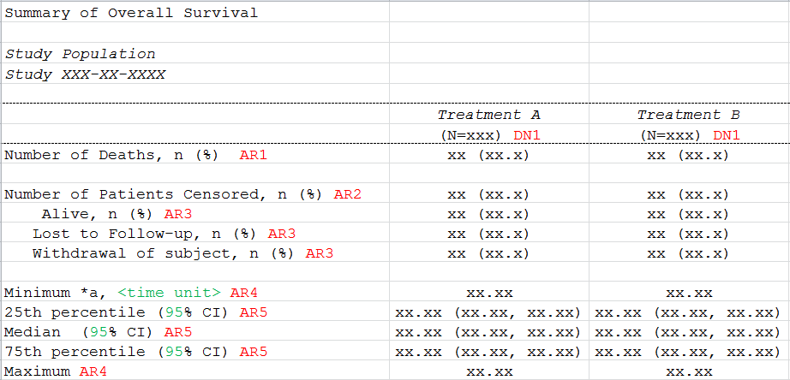
Exercise #2 Oncology Mock Table

Slide 47
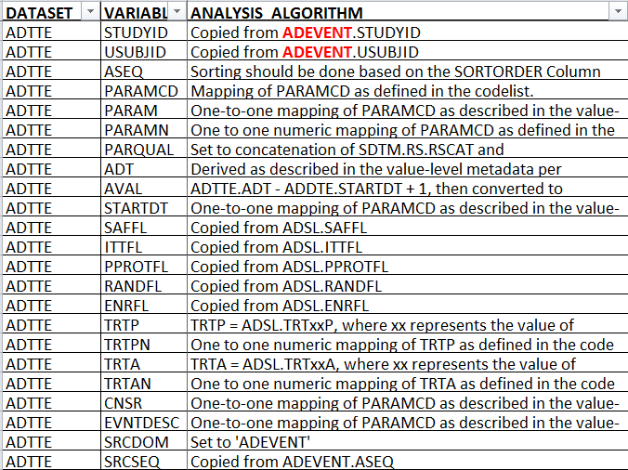
Exercise #2 Oncology Standard

Slide 48
Exercise #2 Answer
Value of PARAM | Overall Survival
Number of Unique Values for CNSR | 4
Events for subjects with CNSR=0 | Death
Events for subjects with CNSR>=1 | Alive
 | Lost to Follow Up
 | Withdrawal of Subject

Slide 49

Module 5 Summary
BDS has “analysis descriptor” variables that are used to impart knowledge about how the record was derived and/or used for analysis. These variables include analysis windowing variables and DTYPE
DTYPE is of high importance
ANLzzFL is a multiple purpose variable used to flag records that fulfill a condition or algorithm
BDS has rules and these rules are in place to prevent people adding columns which would reduce the integrity of the structure
Time to Event is a common methodology and can be implemented using BDS variables to support censoring

Slide 50
End of Lilly Module 5 ☺

